Slide 1



BOOK MOTION
LIBRARY SERVICES
Presented by: Niraj Paradva

Slide 2




SHRI S. V. PATEL COLLEGE
VEER NARMAD SOUTH GUJARAT UNIVERSITY
MINOR PROJECT

Slide 3




ESSENTIAL COMPONENTS
TOOLS USE IN PROJECT
UML & ABOUT
OBJECTIVE
IMAGES & INTRO

Slide 4



INTRODUCTION
The main purpose of the project is to is to build an online LMS system by using different software methodologies. The LMS with the basic and necessary features like the admin/librarian can add/delete book, can add/delete author, can issue books, can manage books and users, and users/students can search and borrow books.

Slide 5

TOOLS FOR PROJECT
Front End
html
css
bootstrap
java script
google fonts
jquery
Back End
hypertext preprocessor
mysql database
ajax live searching

Slide 6



OBJECTIVES
The primary objective of any library system is to collect, store, organize, retrieve and make available the information sources to the information users.
Makes Library Cost-Effective.
Easy Accessibility
Eliminates/Reduces Errors in Data Management

Slide 7

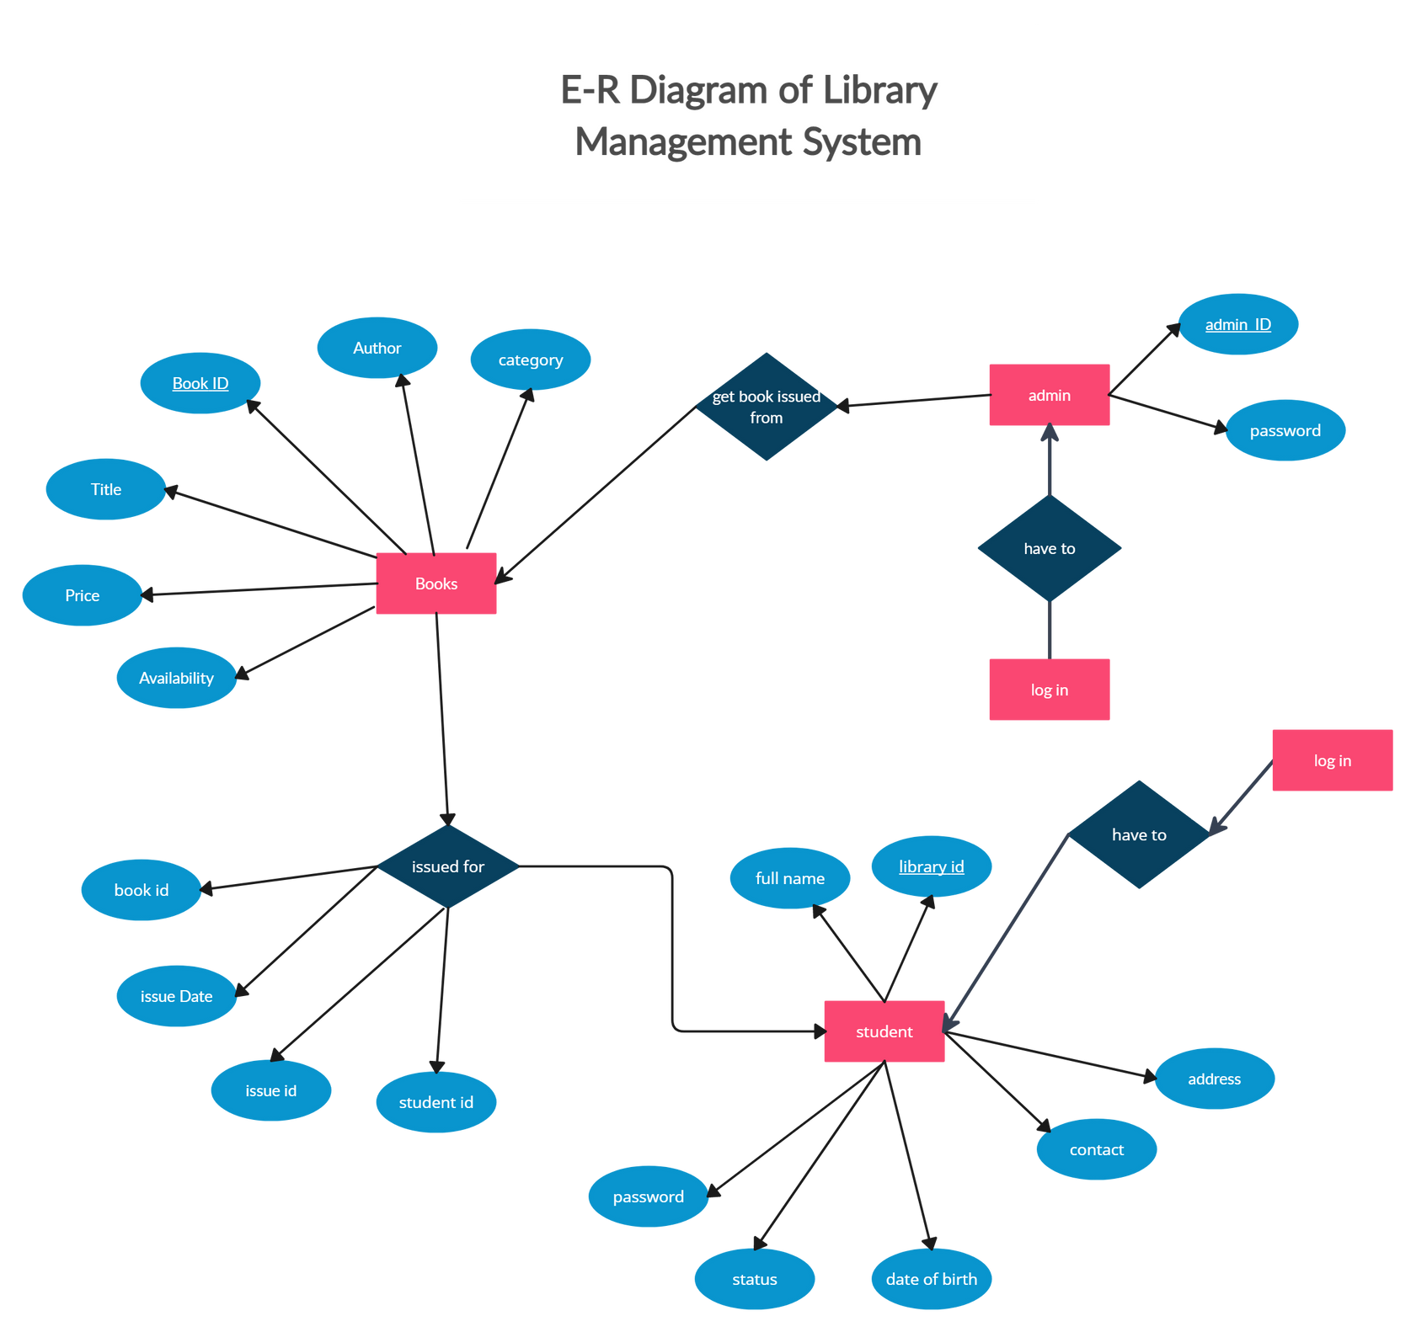

ER DIAGRAM

Slide 8


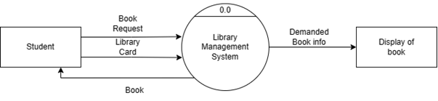
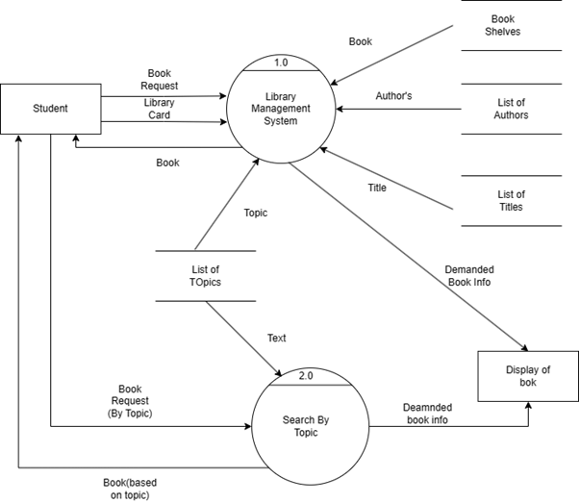
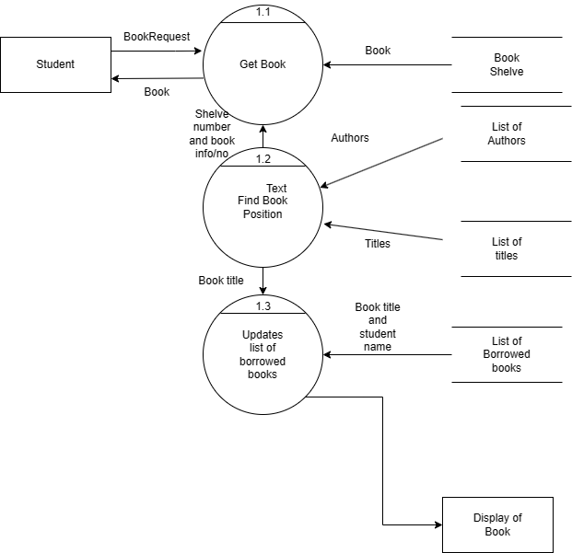

DFD LEVEL-0
DFD LEVEL-1
DFD LEVEL-2

Slide 9
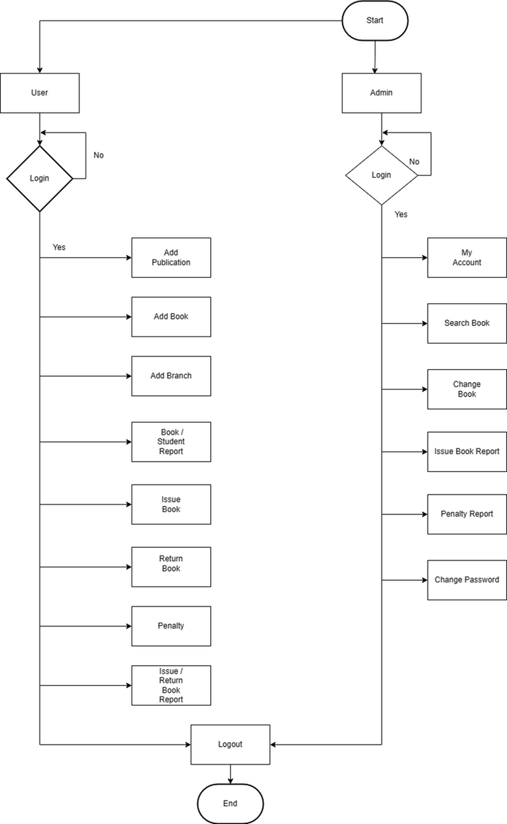
FLOW CHART

Slide 10


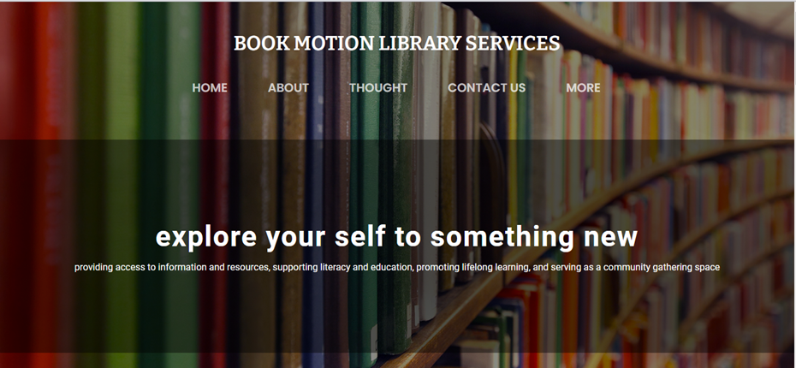

CONTACT US
HOME PAGE HEADER

Slide 11
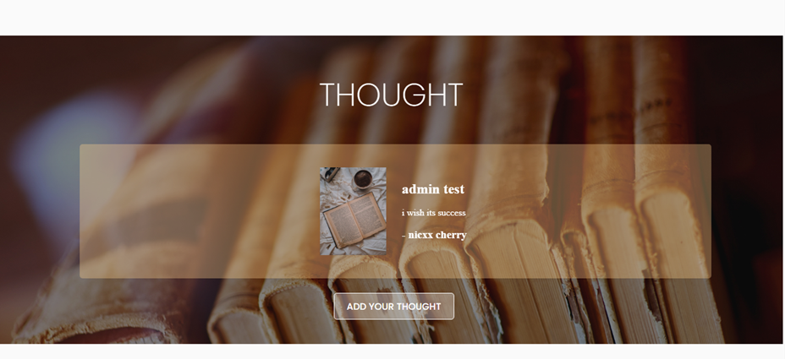
STUDENT THOUGHT

Slide 12
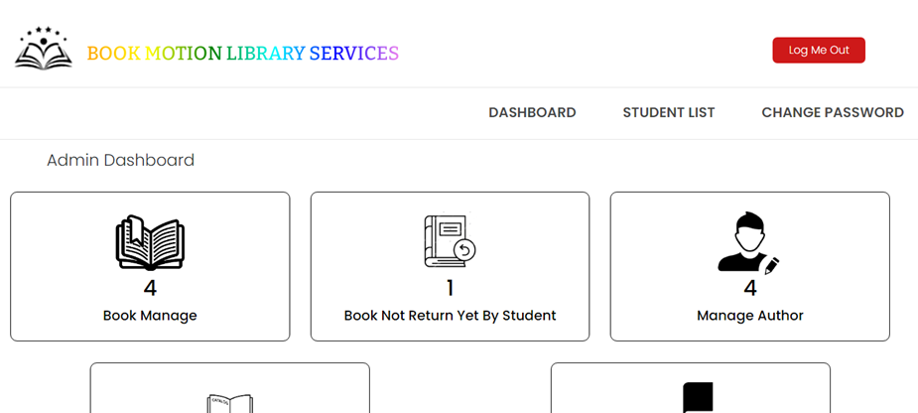
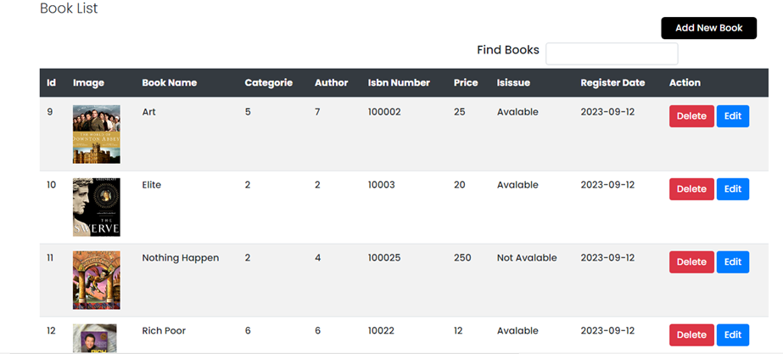
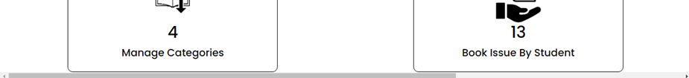
ADMIN DASHBOARD
admin can manage book,student,author,categories etc.
also can issue book for student
ADMIN HOME
BOOK SHELF

Slide 13
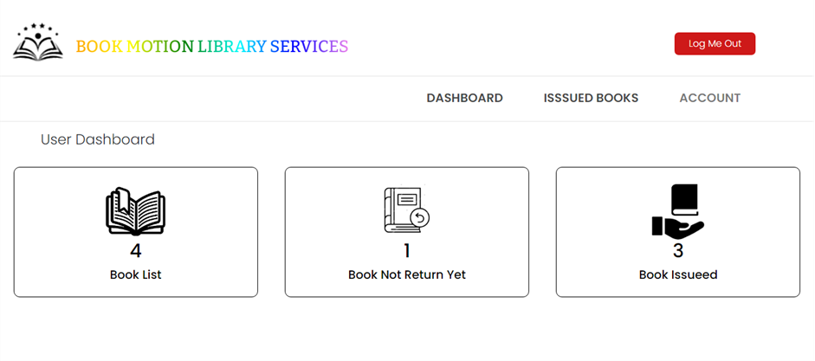
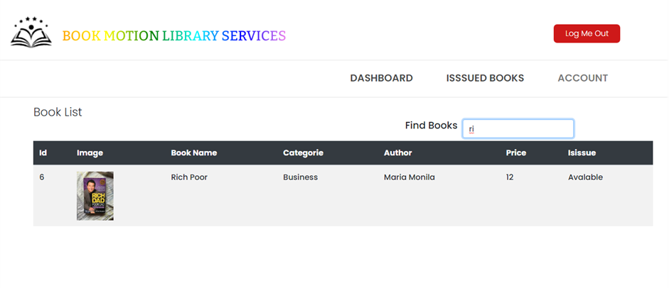


USER
STUDENT DASHBOARD
VIEW BOOK & STATUS
LIVE SEARCH

Slide 14


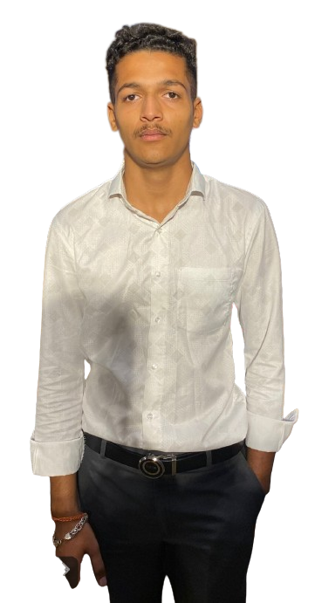



SUBMITTED TO
DEVELOPED BY
NIRAJ PARADVA

Slide 15


CONCLUSION
This project is focused on the development of a system that is both efficient and user friendly when it comes to providing library management service to the users. For achieving the goal, I used PHP, MySQL and JavaScript bootstrap and so on. The challenging part of the project is to design and implement of the database. After overcoming the challenges, I successfully implemented the project and tested it necessary functionalities. All the basic functionality testing is successful which the I planned to do in the LMS. The project is in beginning stage and it’s not fully ready to actual use, as there is need to add more functionality to ensure good user experience. As example currently the user can’t borrow a book directly by themselves. They need to put a request to the admin and the admin can only issue a book to the user. Despite its flaws, the LMS can perform the essential functions required by a library management system.

Slide 16

reference
design idea
https://demo.templatemonster.com/demo/53902.html?off=consource for attractive design.
uml designing
https://app.creately.com/ for designing my uml in simple and batter way
logic refrence
https://www.youtube.com/
i) Code with harry
ii) Cyber warrier
iii) Phpgurukul

Slide 17
THANK YOU FOR LISTENING!
Don't hesitate to ask any questions!

